Slide 1
Customer Churn Analysis
Telecom Industry | Predictive Analytics & Customer Retention Strategy

Slide 2
Agenda
1. Business Problem & Objective
2. Dataset Overview
3. Key Insights from EDA
4. Churn Prediction Model & Performance
5. Feature Importance (Explainability)
6. Customer Segmentation
7. Recommendations

Slide 3
Business Problem & Objective
• Telecom industry is highly competitive — acquiring a new customer costs 5-25x more than retaining an existing one
• Objective: Predict which customers are likely to churn before it happens
• Use SQL aggregation + Machine Learning classification to identify at-risk customers
• Segment customers (At Risk, Loyal, Dormant) to enable targeted retention strategies
• Deliver actionable, data-driven recommendations to reduce churn

Slide 4
Dataset Overview
Total Customers: 7,032
Features: 21 (demographics, services, billing, contract)
Target Variable: Churn (Yes / No)
Overall Churn Rate: ~26.5%
Source: Telco Customer Churn Dataset

Slide 5
Key Insight: Contract Type Drives Churn

Slide 6
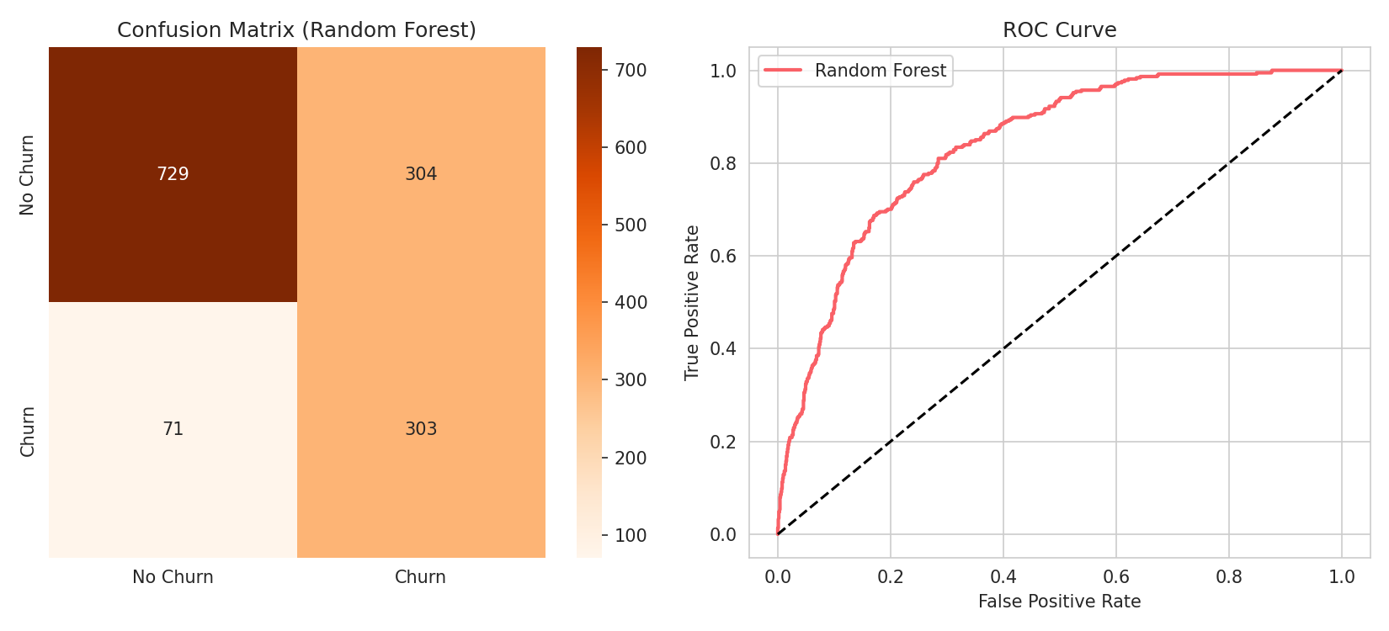
Model Performance
Random Forest Model — ROC-AUC Score: 0.84

Slide 7
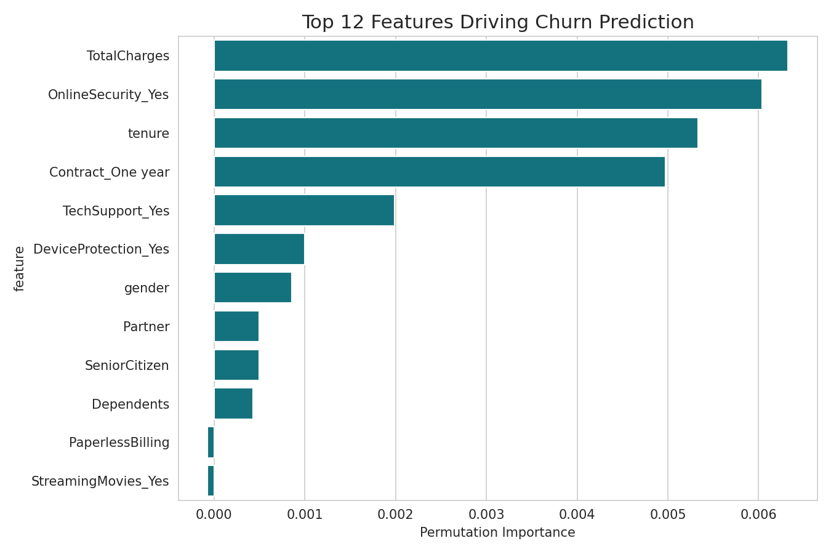
Feature Importance (Model Explainability)

Slide 8
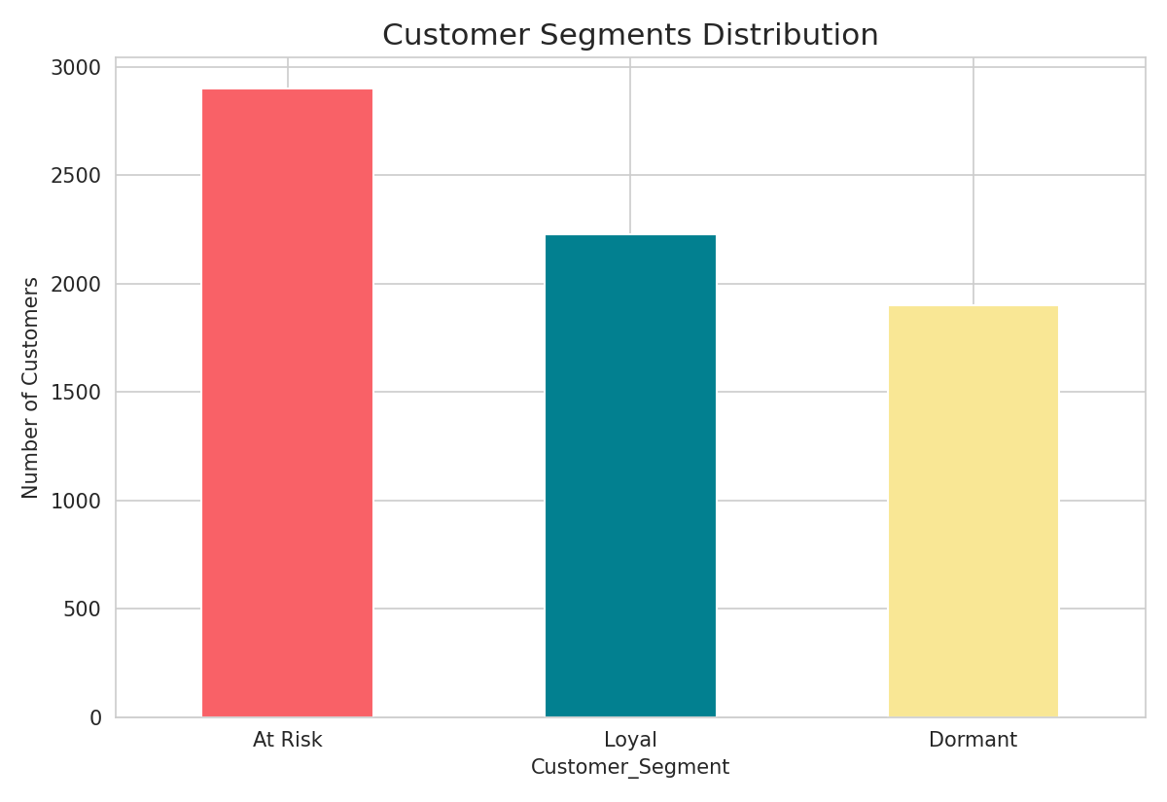
Customer Segmentation
• At Risk: 2900 customers — needs urgent retention action
• Loyal: 2230 customers — reward & retain
• Dormant: 1902 customers — re-engage with offers

Slide 9
Final Recommendations
• At Risk: Offer contract-upgrade discounts and free TechSupport/OnlineSecurity trials
• Loyal: Launch referral & loyalty programs, cross-sell additional services
• Dormant: Re-engage with personalized offers and feedback surveys
• Switch Electronic Check users to auto-pay with small incentives
• Target 'At Risk' segment proactively to reduce churn by an estimated 5-10%

Slide 10
Thank You

